Slide 1
REAL-TIME DIRECTIONAL ANTENNA ALIGNMENT USING REINFORCEMENT LEARNING AND RSSI FEEDBACK Atul Tiwari (THA079BEI006) Bibek Joshi (THA079BEI007) Inisha Maharjan (THA079BEI012) Suprim Koirala (THA079BEI043) Supervisor: Er. Saroj Shakya Department of Electronics and Computer Engineering Institute of Engineering, Thapathali Campus March 29, 2026

Slide 2
Presentation Outline
Motivation
Introduction
Objectives
Scope of Project
Methodology
Results
Analysis of Results
Future Enhancements
Project Applications
Conclusion
Appendices
References

Slide 3
Introduction
Directional antennas focus energy to improve SNR & range
Alignment crucial for reliable communication
Manual alignment is time-consuming and error-prone
Existing automated methods require costly RF hardware
Low-cost, RSSI-based autonomous alignment is needed

Slide 4
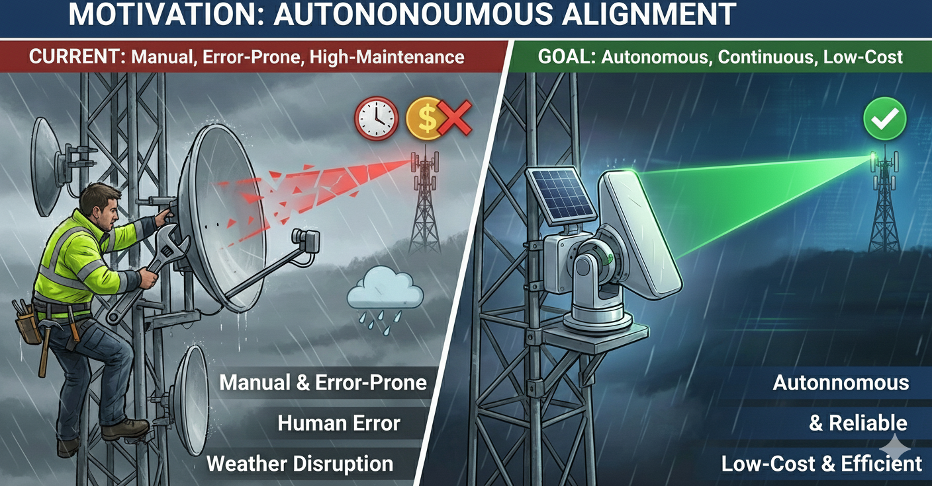
Motivation
Figure: Image Generated by NanoBanana (Gemini)

Slide 5
Objectives
To design and implement a low-cost embedded system capable of measuring RSSI in real time and mechanically steering a directional antenna
To develop and evaluate lightweight reinforcement learning-based alignment strategies, comparing their performance against baseline methods

Slide 6
Scope of Project
Capabilities
Implement stepper-controlled antenna using microcontroller
Develop baseline RSSI scanning and hill-climb algorithms
Integrate lightweight reinforcement learning for antenna control
Evaluate performance in static and dynamic environments
Limitations
Advanced multi-antenna systems like MIMO, phased arrays
High-frequency mm-Wave and beamforming techniques
Transmitter-side adaptation or coordinated alignment
Full mobility and high-speed movement scenarios
RSSI variability limits experimental repeatability

Slide 7
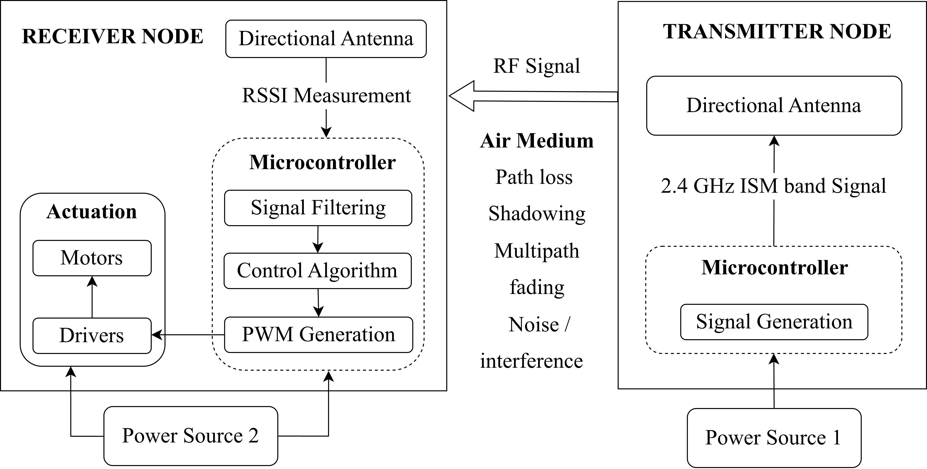
Methodology (1) System Block Diagram

Slide 8
Methodology (2) Hardware Implementation
Antenna: High-gain directional Yagi PCB Type.
Processor: ESP32-S3 for logic execution.
Actuator: NEMA 17 Stepper Motor for precision.
Driver: A4988 driver for smooth motor control.
Power: External 12V supply for motor torque.

Slide 9
Methodology (3) Source and Receiver Configuration
Transmitter Node​
Receiver Node​
ESP32 microcontroller​
Directional antenna​
Periodic Data Transfer
ESP32 microcontroller​
Directional antenna​
Stepper motor assembly
Alignment Algorithm

Slide 10
Methodology (4) Software Implementation
Arduino IDE and PlatformIO with ESP32-S3 Core
Embedded C/C++ Firmware Development
Lightweight Q-Learning Algorithm
Serial Monitor and Plotter
Python for Data Analysis, Simulation
Matplotlib for Data Visualization, KiCad for circuit diagrams

Slide 11
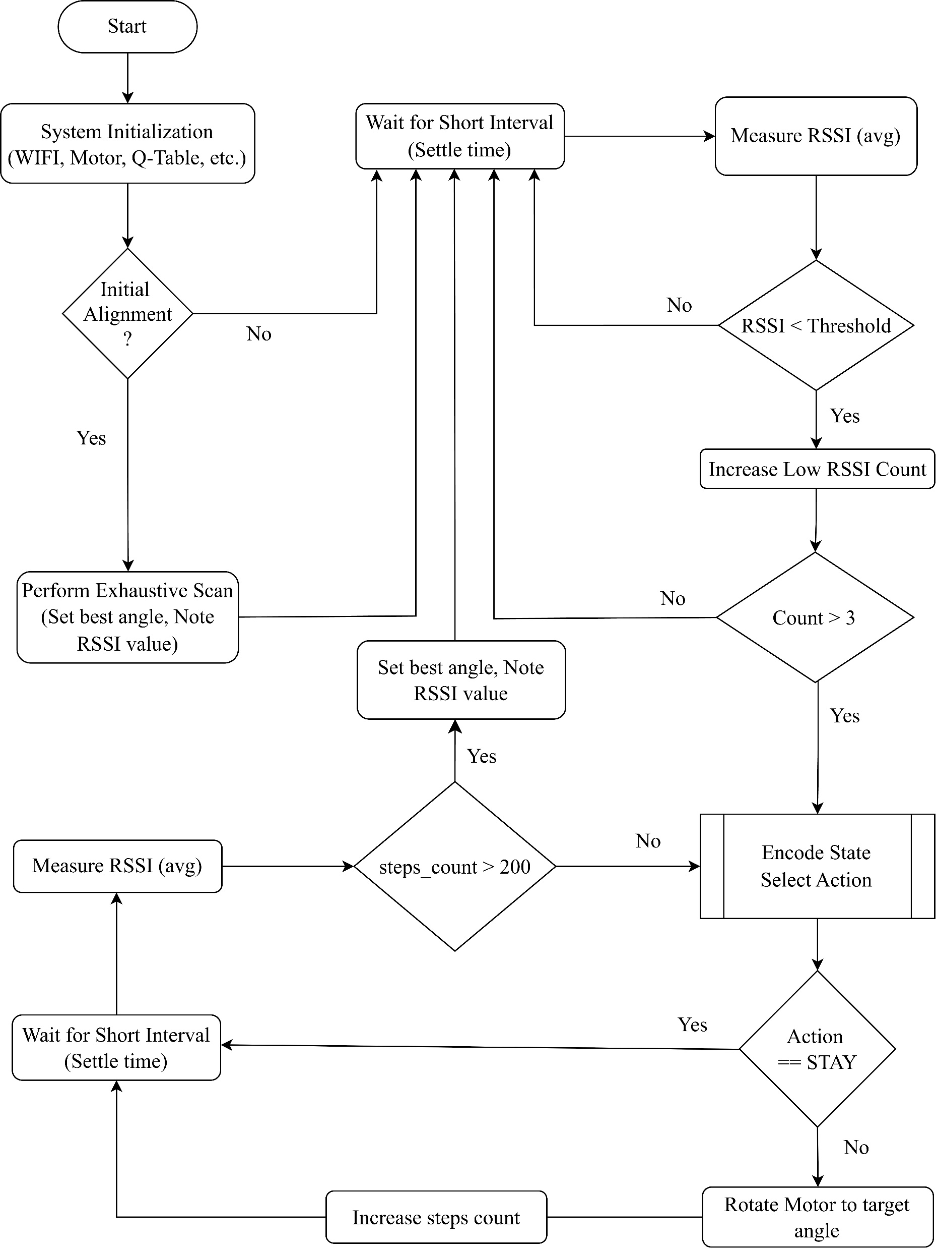
Methodology (5) System Flow Diagram

Slide 12
Methodology (6) Baseline Methods
Exhaustive angular scanning
This approach maps the entire search space to find the absolute best location, providing high accuracy but low efficiency.
RSSI-based hill-climbing
This method starts at a random point and iteratively moves to adjacent points with higher RSSI values until it hits a local maximum. It is fast but can get trapped in local maxima.

Slide 13
Methodology (7) Reinforcement Learning Overview
Model-free control paradigm
Learn from interaction & rewards
Optimize antenna orientation over time
Tabular Q-Learning
Suitable for low-cost embedded systems

Slide 14
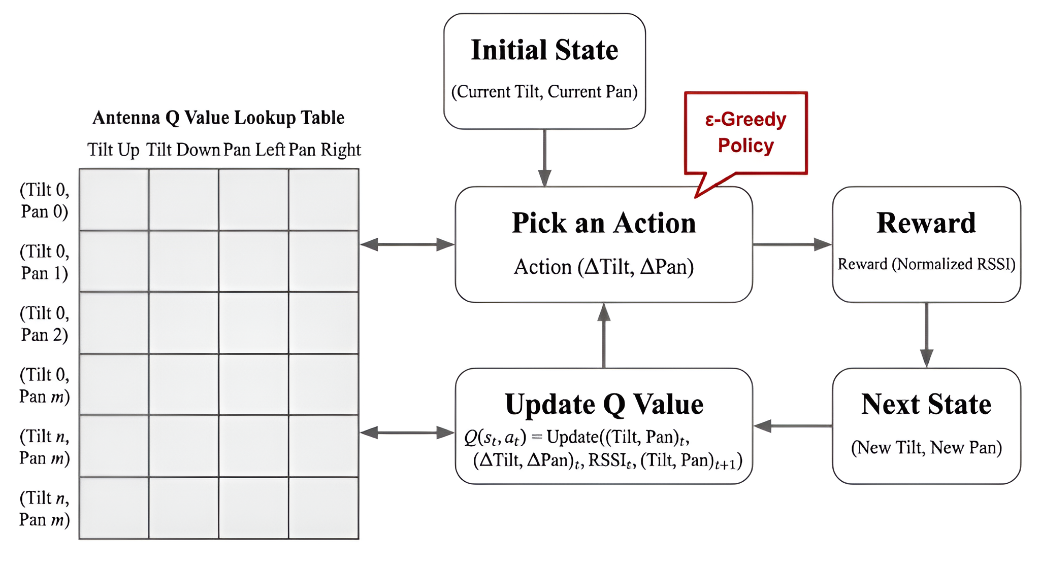
Methodology (8) RL Model Design

Slide 15
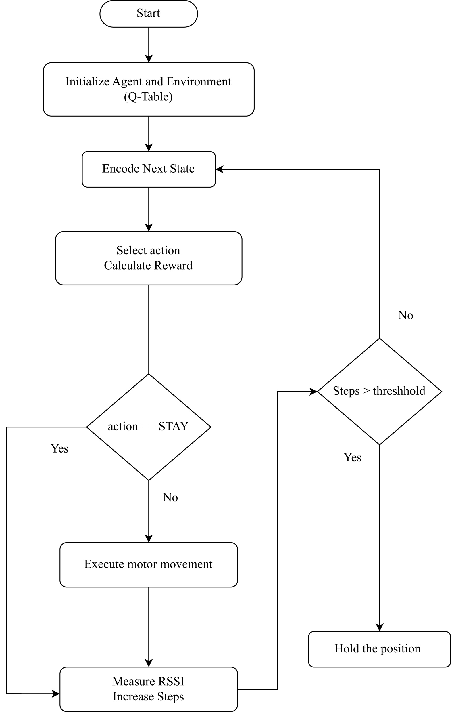
Methodology (9) RL Control Flow

Slide 16
Methodology (10) Reinforcement Learning Framework
State Space:
Current RSSI level and signal trend.
Current angular position of the antenna.
Thresholds classify RSSI increase/decrease/stable
Action Space:
Rotate clockwise, counter-clockwise, or stay.
Step size trade-off: precision vs. speed
Reward Function:
Positive reward for increased signal strength.
Penalty for signal drops or unnecessary movement.

Slide 17
Methodology (11) RL Limitations
Dependence on discretization
Generalization limits
Sensitivity to the training environment

Slide 18
Methodology (12) Experimental Setup
Indoor lab/corridor for multipath testing
Outdoor line-of-sight environment
Random initial antenna misalignment
Repeated trials (N ≥ 10) for reliability

Slide 19
Methodology (13) Evaluation Metrics
RSSI (primary signal strength)
Movement Count
Convergence Time ​
Success Rate
RSSI Variability

Slide 20
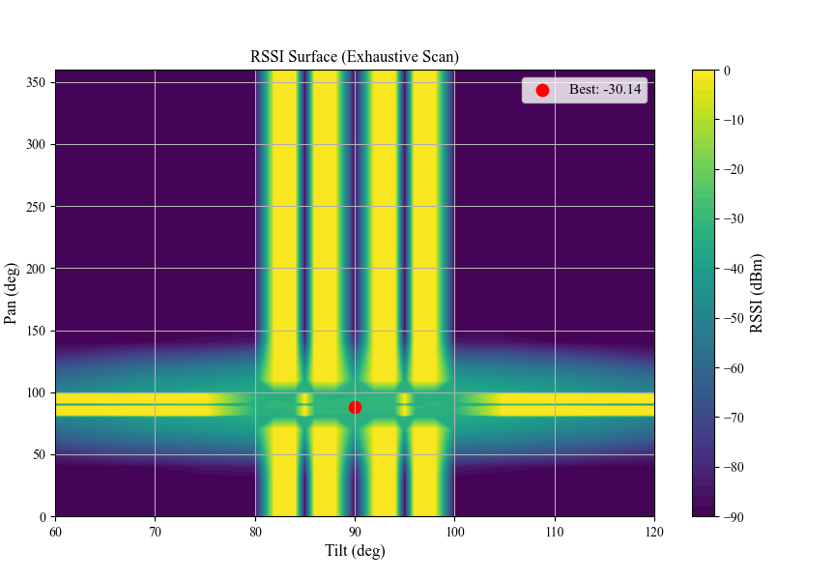
Results (1) Exhaustive Scanning
Global maximum RSSI of −30.14 dBm at an antenna orientation of (𝜃pan, 𝜃tilt) = (88°, 90°)
945 mechanical steps and 18900 RSSI samples
Approximately 67.7 seconds of convergence time

Slide 21
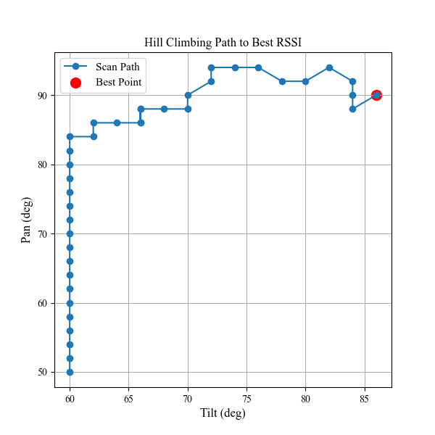
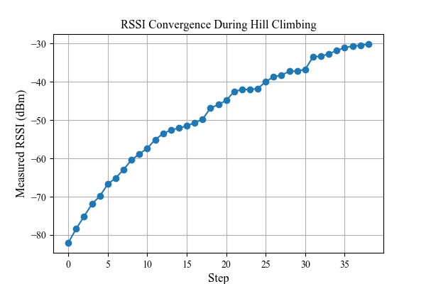
Results (2) Hill Climbing

Slide 22
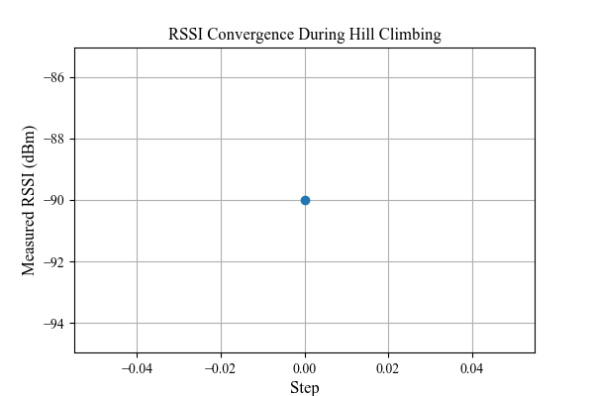
Results (3) Hill Climbing at Bad Initialization

Slide 23
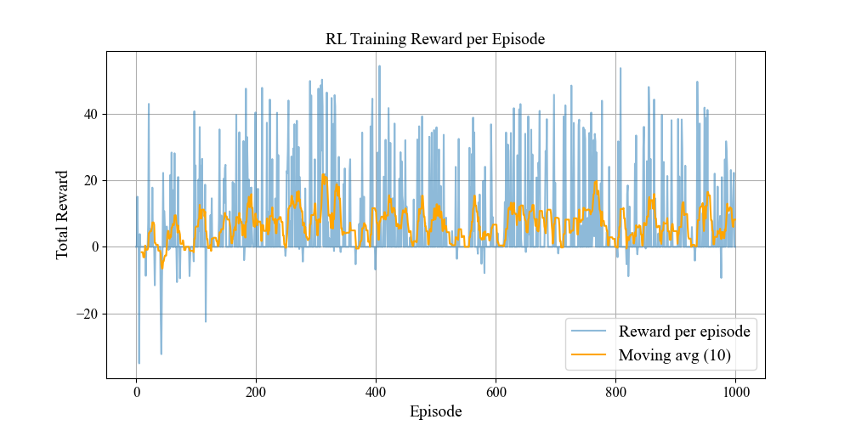
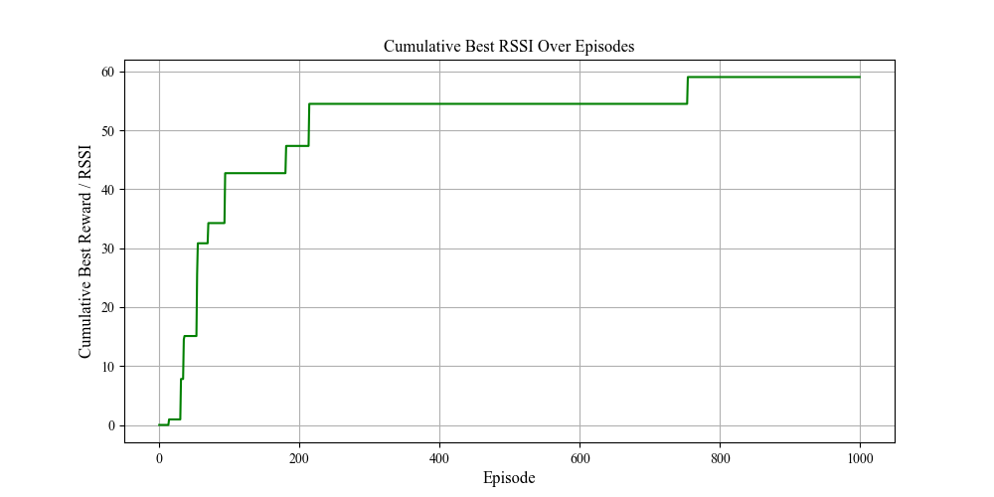
Results (4) RL Learning Convergence

Slide 24
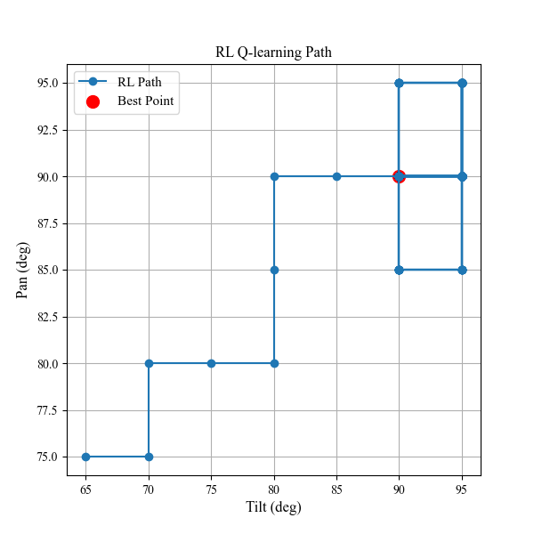
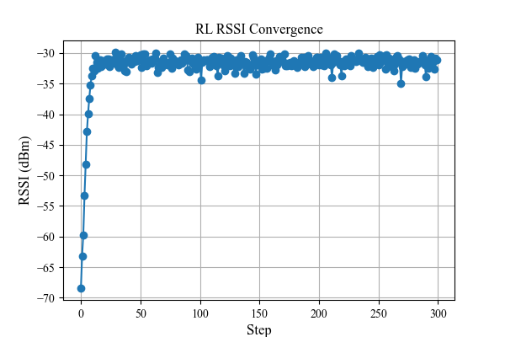
Results (5) RL Performance

Slide 25
Results (6) Average Simulation Performance
Metric | Exhaustive Scan | Hill Climbing | Q-Learning
Best RSSI Achieved (dBm) | -30.14 | -32.13 | −30.82
Optimal Pan Angle (deg) | 88 | 90 | 90
Optimal Tilt Angle (deg) | 90 | 86 | 90
Convergence Time (s) | 67.68 | 6.51 | 5.51
Number of Steps Taken | 945 | 39 | 25
Total RSSI Samples | 18,900 | 780 | 500
Initialization Sensitivity | None | High | Low
Ability to Escape Local Maxima | Not Applicable | No | Yes
Suitability for Embedded Use | Low | Medium | High

Slide 26
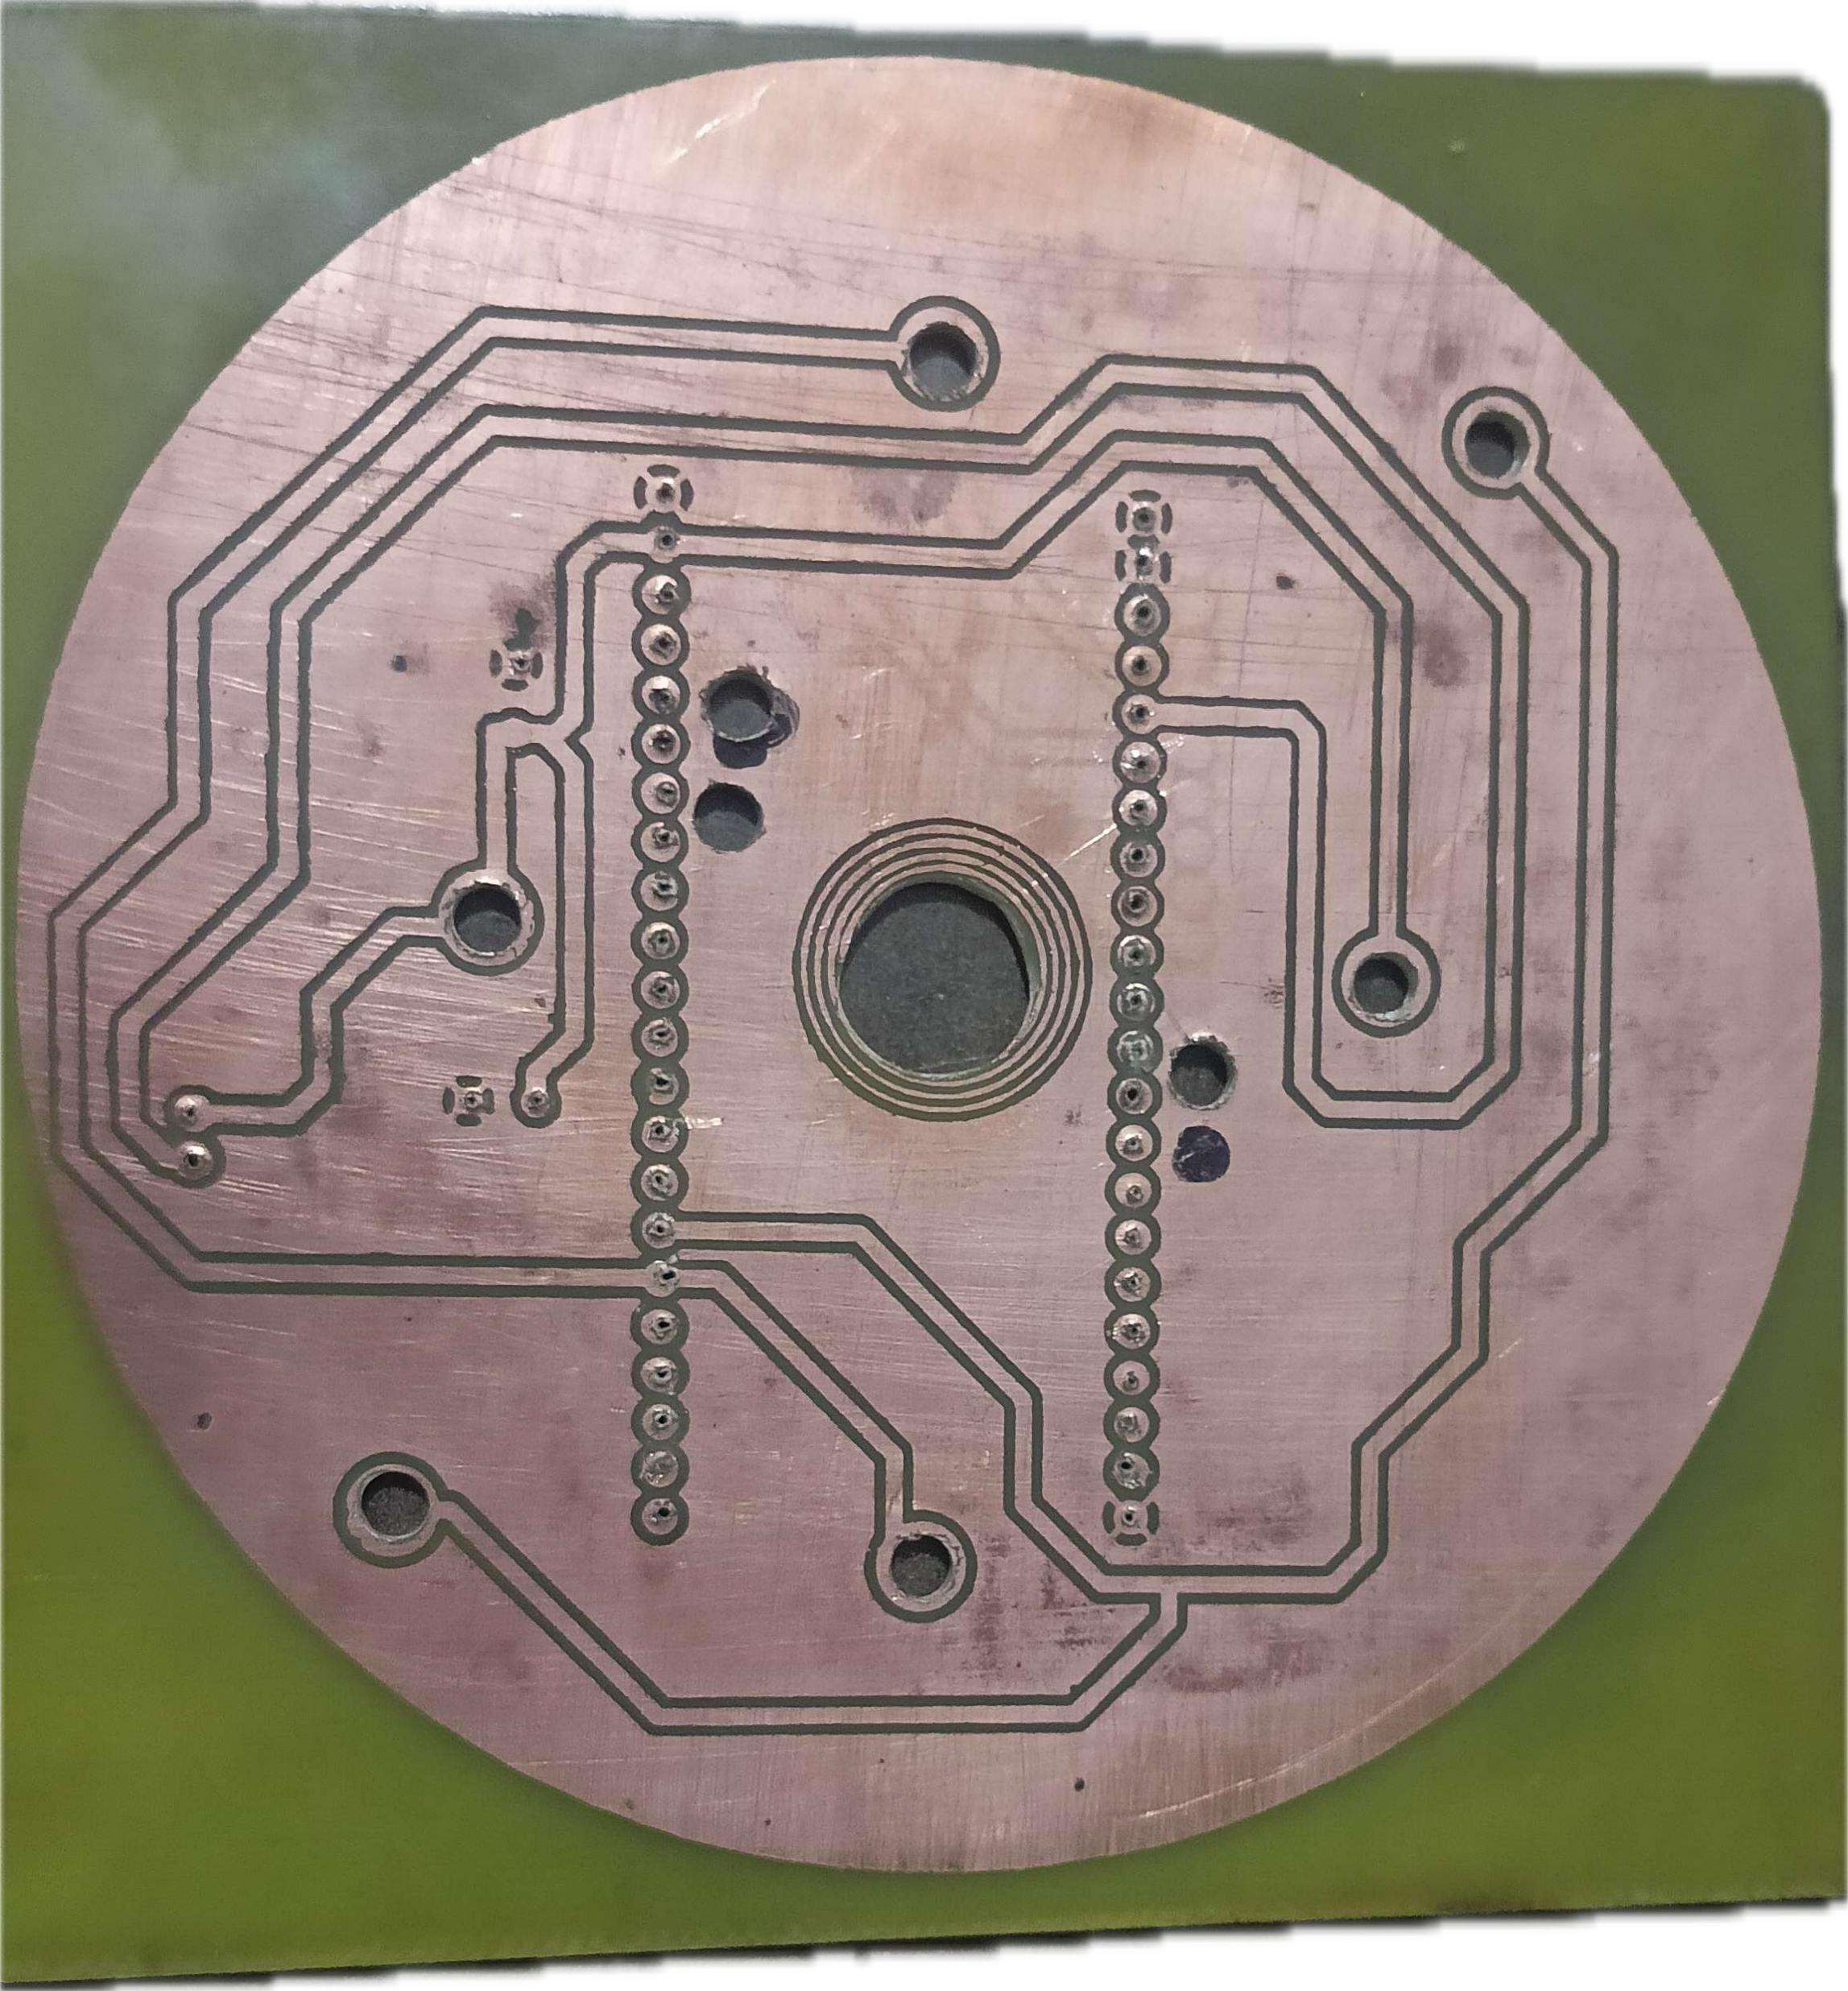
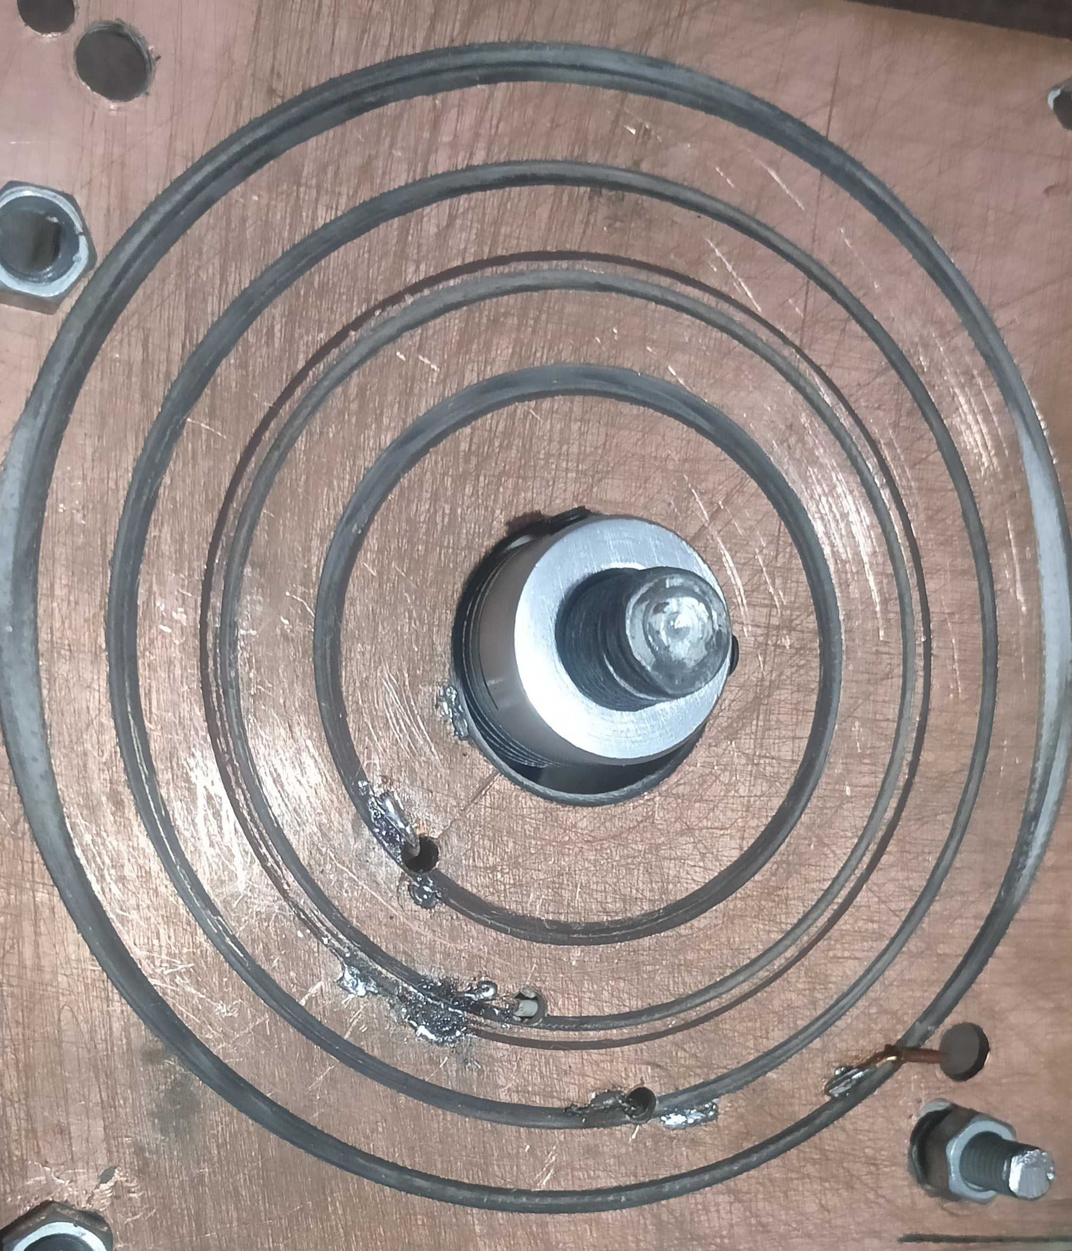
Results (7) PCB and Slip-Ring Design

Slide 27
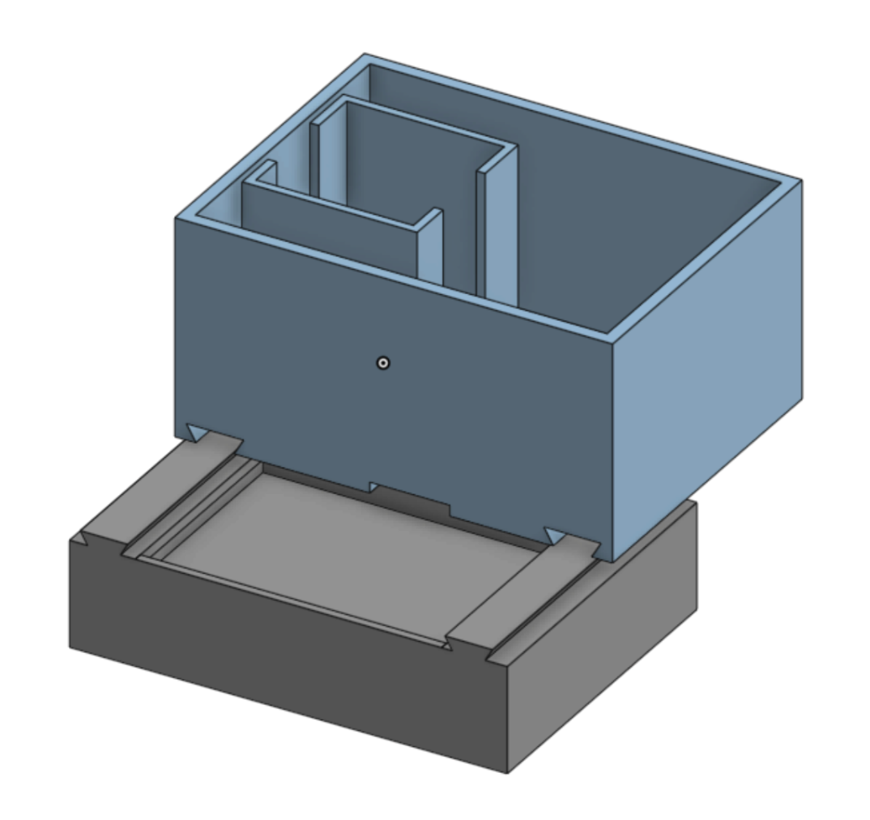
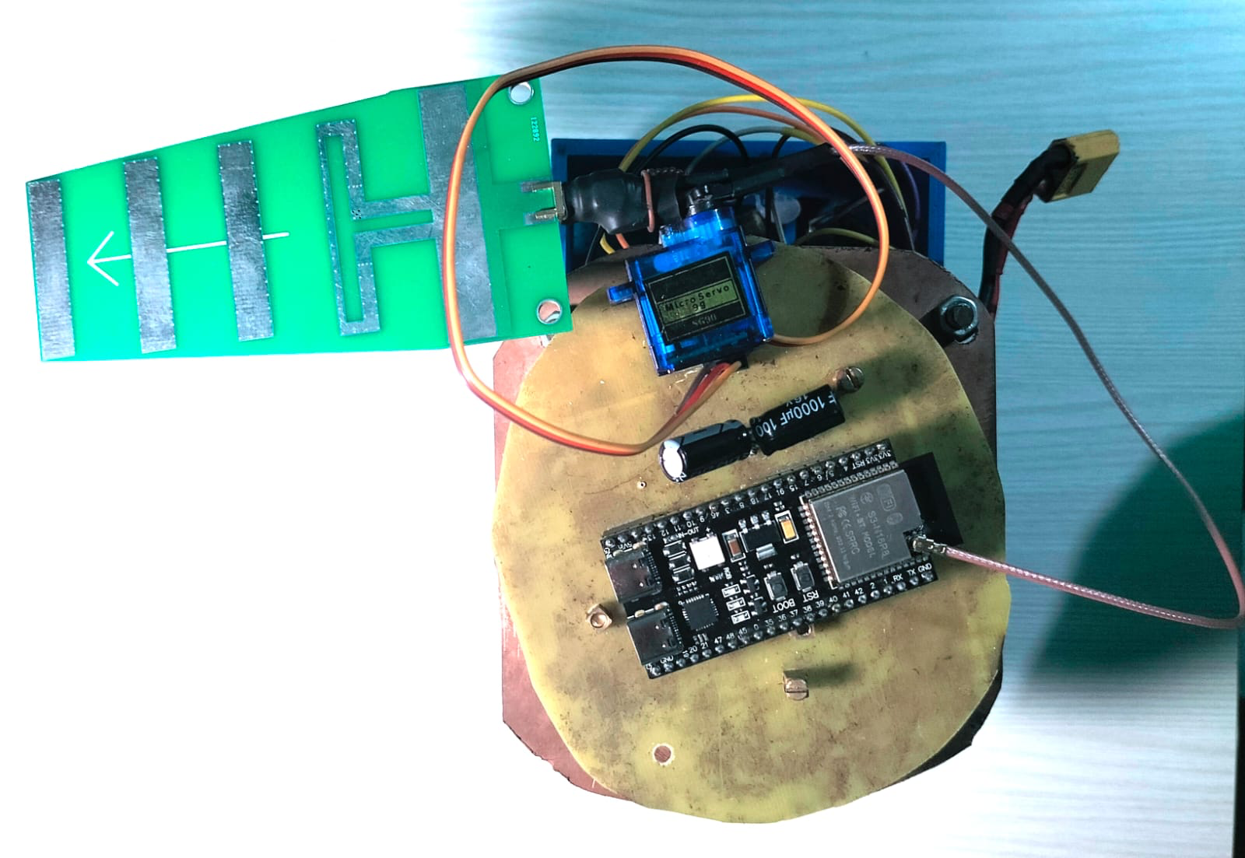
Results (8) Hardware Design

Slide 28
Results (9) Average Practical Performance
Method | Avg. RSSI (dBm) | Avg. Time (s) | Avg. Moves | Success (%) | RSSI Std. Deviation (dB)
Exhaustive | -49.95 | 54.20 | 812 | 100 | 1.60
Hill-Climbing | -52.73 | 11.84 | 63 | 80 | 2.34
Q-Learning | -49.55 | 9.62 | 57 | 95 | 1.28

Slide 29
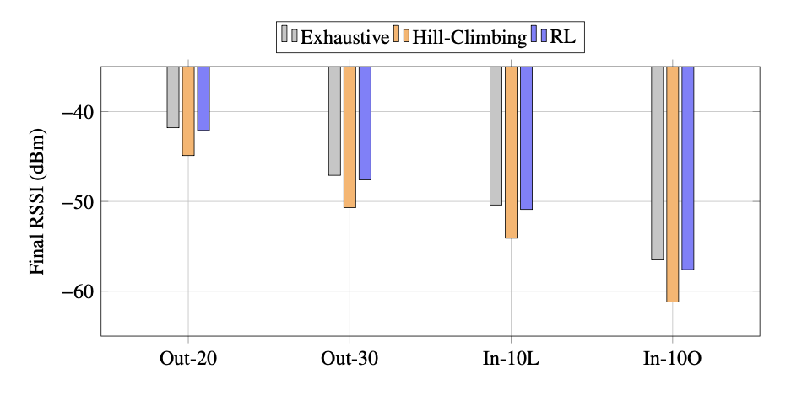
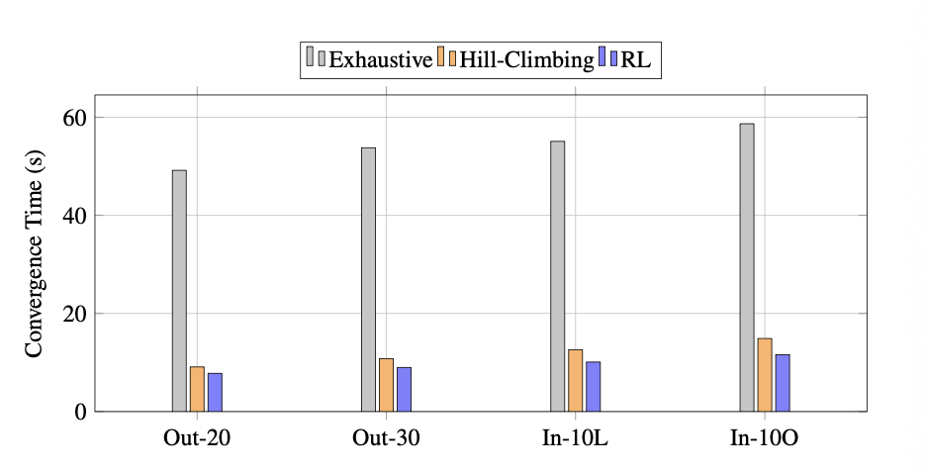
Results (10) Average Practical Performance

Slide 30
Analysis of Results (1)
RL learns directional correlation instead of brute-force search
RL Utilizes historical RSSI trends for decision making
RL Avoids repeated exploration of low-reward orientations
Exhaustive Scan guarantees global optimum
Hill Climbing converges faster but is sensitive to the initial antenna orientation

Slide 31
Analysis of Results (2) Simulation to Practical Deviation
Method | Simulation RSSI (Avg.) | Practical RSSI (Avg.) | ΔRSSI (dB) | Simulation Time (s) | Practical Time (s) | ΔTime
Exhaustive Scanning | -30.14 | -48.95 | -18.75 | 67.68 | 70.20 | 3.6%
Hill-Climbing | -32.13 | -52.73 | -22.60 | 6.51 | 11.84 | 81.9%
Q-Learning (RL) | -30.82 | -49.55 | -19.73 | 5.51 | 9.62 | 74.6%

Slide 32
Future Enhancements
Mechanical and Hardware Improvements
Algorithmic Improvements
Embedded Software Enhancements
System-Level Extensions

Slide 33
Project Applications
Improving reliability and range of fixed wireless links
Enhancing signal stability in IoT or sensor networks with directional antennas
Low cost point-to-point wireless communication systems where manual alignment is impractical
Educational and research platforms for exploring embedded RL in real-time RF control

Slide 34
Conclusion
Successfully implemented autonomous antenna alignment using ESP32-S3 and Q-learning
RL reduced alignment time by 82.25% compared to exhaustive scanning
Offers useful time-accuracy trade-off rather than absolute RSSI superiority
Lightweight 12.3 kB Q-table fits easily within embedded memory constraints
Discrete state-space may miss optimal alignments between sampled angles

Slide 35
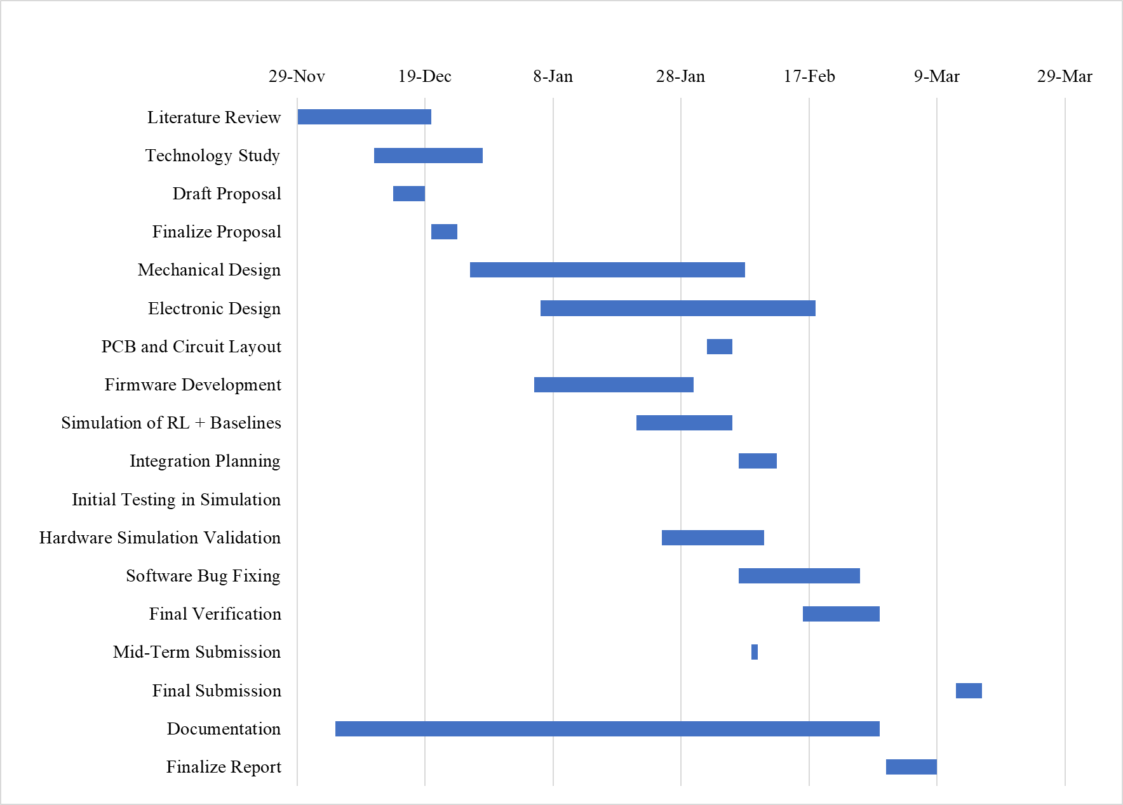
Appendix - I [Gantt Chart]

Slide 36
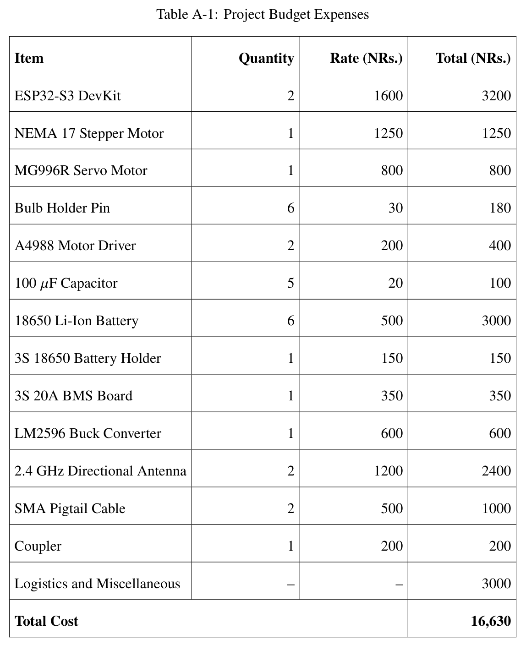
Appendix - II

Slide 37
References I
[1] C. Beard and W. Stallings, Wireless Communication Networks and Systems. Pearson, 2016.
[2] S. Ahmed et al., “Comparative analysis of machine learning algorithms for antenna alignments,” IEEE Access, 2021.
[3] A. T. Koru, J. Chang, and Y. Wan, “RSSI-based distributed control to align directional antenna pairs for UAV communication,” IEEE/ASME Transactions on Mechatronics, 2024.
[4] Y. Wan et al., “Received signal strength indicator-based decentralized control for robust long-range aerial networking using directional antennas,” IEEE Transactions on Aerospace and Electronic Systems, 2018.

Slide 38
References II
[5] J. W. Smith et al., “SmartAntenna: Enhancing wireless range with autonomous orientation,” International Journal of Distributed Sensor Networks, 2019.
[6] Á. L. Makara, B. T. Csathó, A. Rácz, T. Borsos, L. Csurgai-Horváth, and B. P. Horváth, “Deep-Learning-Based Antenna Alignment Prediction for Mobile Indoor Communication,” Sensors, vol. 23, no. 7, p. 3375, 2023, doi: 10.3390/s23073375.
[7] R. S. Sutton and A. G. Barto, Reinforcement Learning: An Introduction, 2nd ed. Cambridge, MA, USA: MIT Press, 2018. ISBN 978-0262039246.

